Slide 1


Voice Control of a HumanOid robot
Shir Graus
Gili Oved
Supervisor: Koby Kohai
CRML Lab

Slide 2
Agenda
Project goals
Technologies overview
Architecture
Demonstration
Conclusion and Improvements

Slide 3
Project Goals
Build voice automated system by Google Assistant interface to control BIOLOID robot motion through MATLAB as a work environment
Support various voice commands

Slide 4
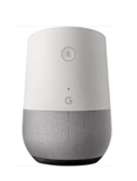
Technologies overview
Google home is a smart device developed by Google. It allows the user to say voice commands to communicate with services through google assistant – personal assistant software for google user. We used these capabilities to control the robot by providing voice commands.

Slide 5
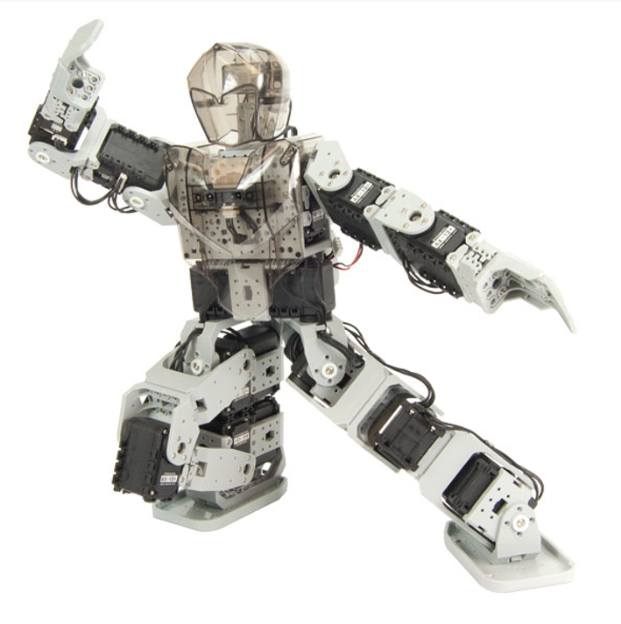
Technologies overview
BIOLOID robot produced by Robotis is a humanoid robot
The robot has an cm-530 controller and 18 ax-12 engines.
It has IR and GYRO sensors.
It has 18 degrees of freedom expressed by 18 engines, six of them in arms and 12 in legs. Each engine has an id number and with this number the controller can communicate with each engine individually.

Slide 6
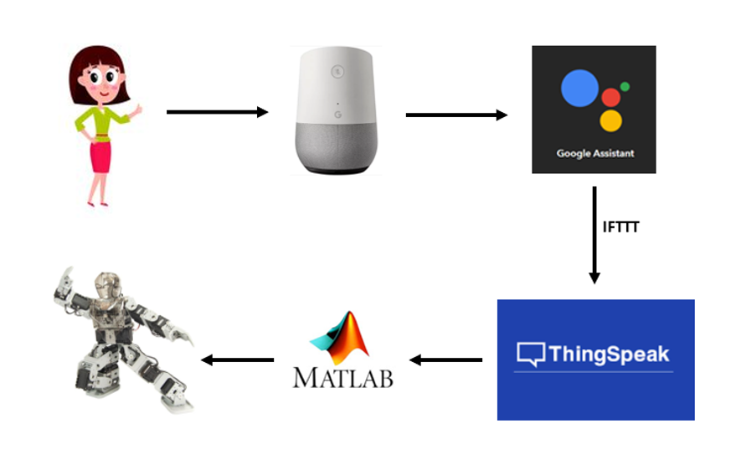
Architecture
We connected the Google Home interface to MATLAB by IFTTT and ThingSpeak .
With the help of those App’s we created a new voice command which translated to Data Vector in MATLAB.

Slide 7
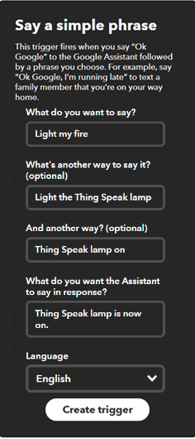
Architecture
We built our work in stages. We have created new voice commands for the Google Home interface through Google Assistant by IFTTT.
We have activated a trigger so that when the voice command we have entered, we will get a change in the vector value that represents the information in the MATLAB software.

Slide 8
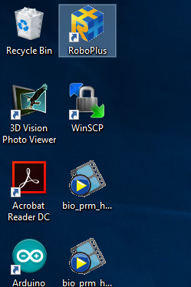

Architecture
We have moved control of the robot programmed into the MATLAB software. In the MATLAB software we made the connection between the two interfaces so that the robot responds to the voice commands.

Slide 9
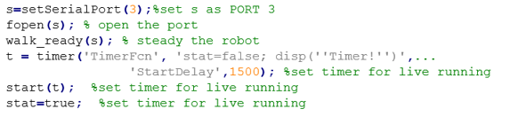
Demonstration
At the beginning of the code, we define the appropriate port for the robot and stabilize it. Then we set a timer for a desirable running time so that the robot will run live in a while loop

Slide 10
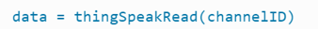
Demonstration
Vector data it is the information vector that contains all the voice changes that comes to MATLAB by the function “ThingSpeakRead”.
The vector contains a value '1' for the last received command and a ‘NaN' value for the other commands. We converted the ‘NaN' to '0' to simplify the work.

Slide 11
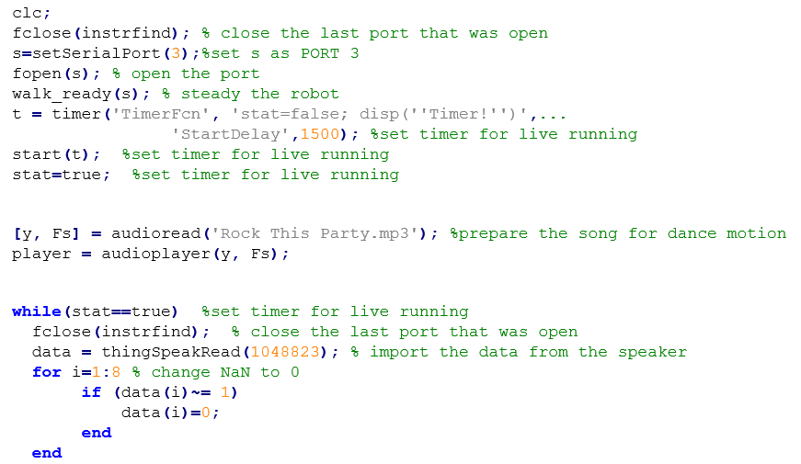
Code example

Slide 12
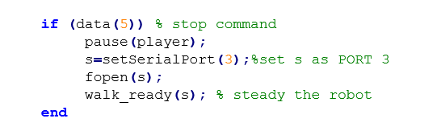
Demonstration
The code is divided into eight cases (Case for each command) When each command is running if the value '1' is found in its place in the vector.

Slide 13
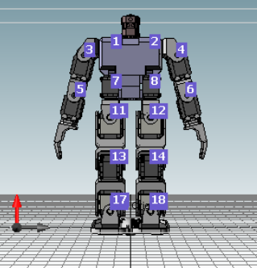
Demonstration
To generate movement, we used a step matrix. Each line in the matrix represents the location of a specific step and each column represents a specific engine.
We are going through the whole matrix, so for every step we will go through all the engines.

Slide 14
Demonstration
We are placing the robot in the desired coordinates by the function "setGoalPosition“ And the strength of the engine movement is determined by the function "setMovingSpeed“.
We took the movements from a previous project and renovated and added more movements of our own.

Slide 15
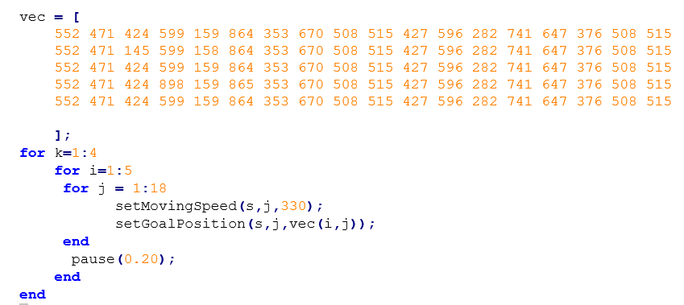
Code example

Slide 16
Demonstration-Demo Video

Slide 17
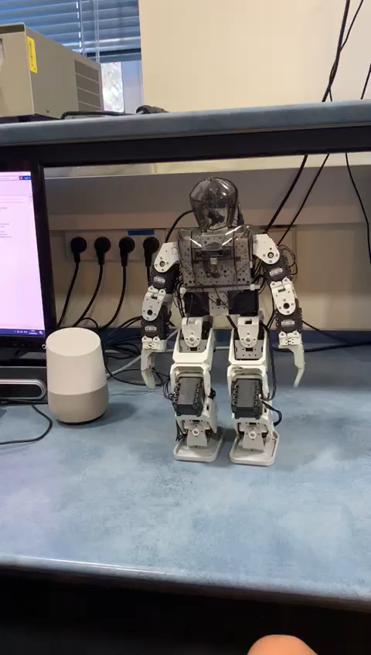

Slide 18
Conclusion and improvements
According to the results of the project, we will recommend the following:
Using the battery to maintain a better balance of the robots rather than using a direct connection to the electricity that limits the robot's movement.
Turning the robot off and on every time something "gets stuck" such a startup helps solve problems.

Slide 19
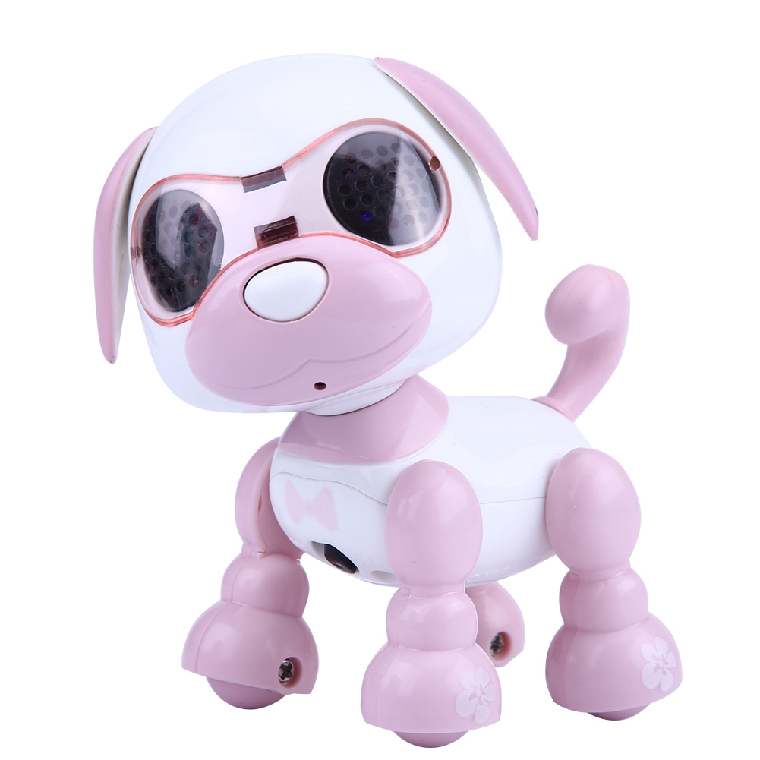
Conclusion and improvements
For a further project, we will offer the following improvements:
Stop the robot in the process and not after it is finished.
working with a robot in different shape to make it more stable so more movements can be done.

Slide 20

Conclusion and improvements
Option for more voice commands.
Add another interface – a graphical display where you can view the chat done with the robot.

Slide 21
Thanks!
Any questions?
Gili Oved
Shir Graus

